Slide 1
Uber Project
Ильясов Руслан и Тигай Тимур

Slide 2
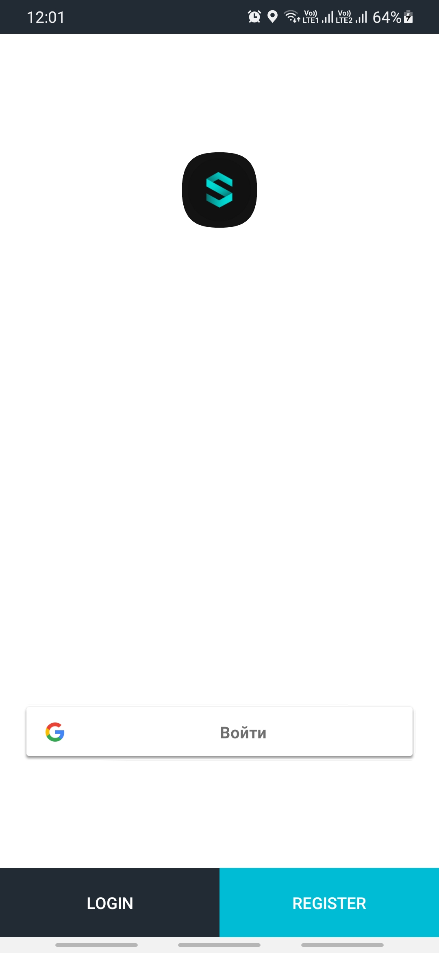
Sign in & Sign up
On this page, users can either create an account or enter the application if an account already exists

Slide 3
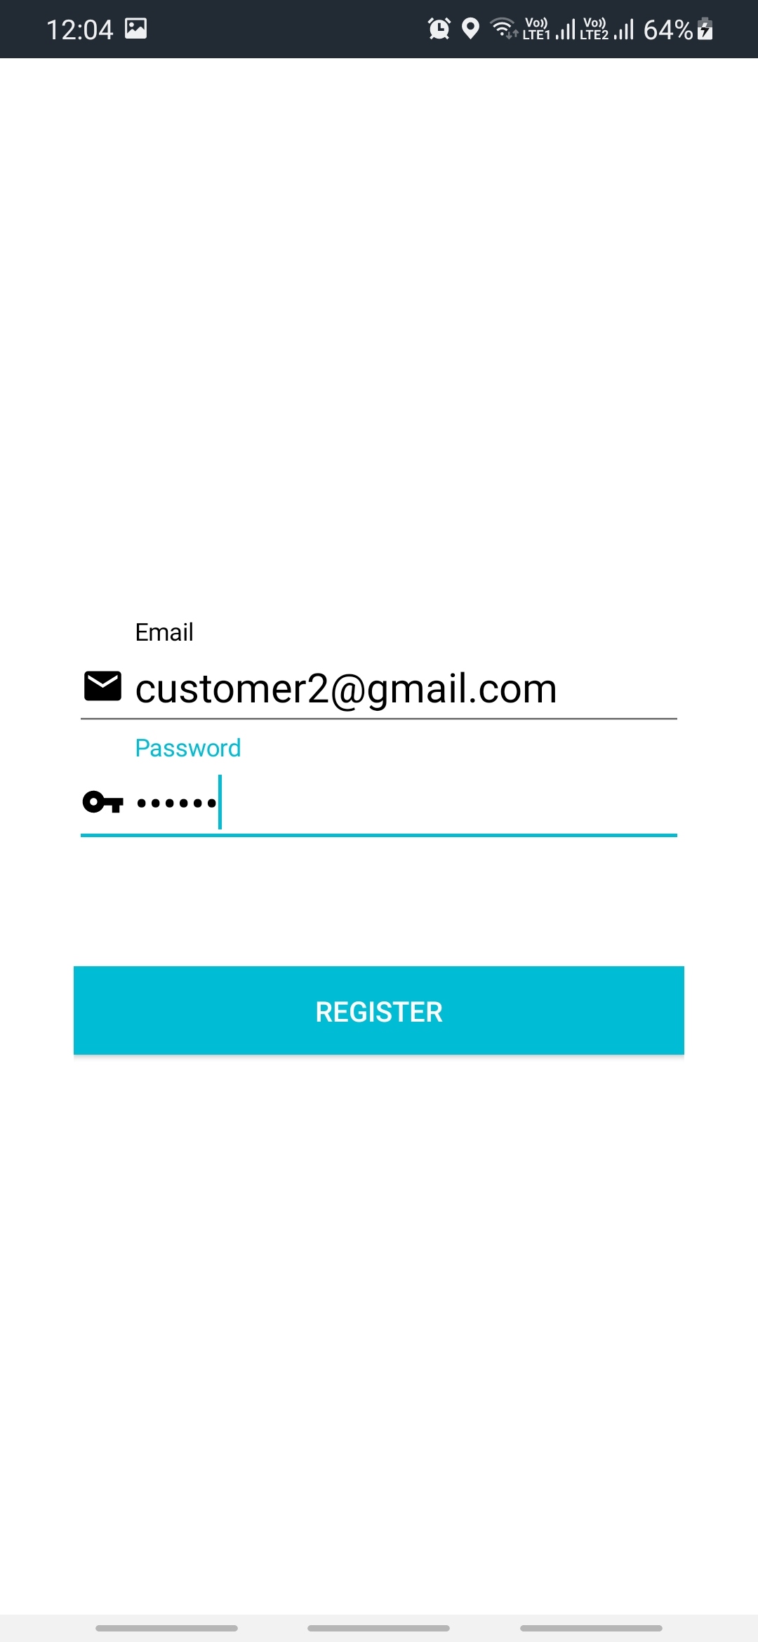
Registration
If you are a new user and you want to create a new account, you will be redirected to this page. This is what registration looks like

Slide 4
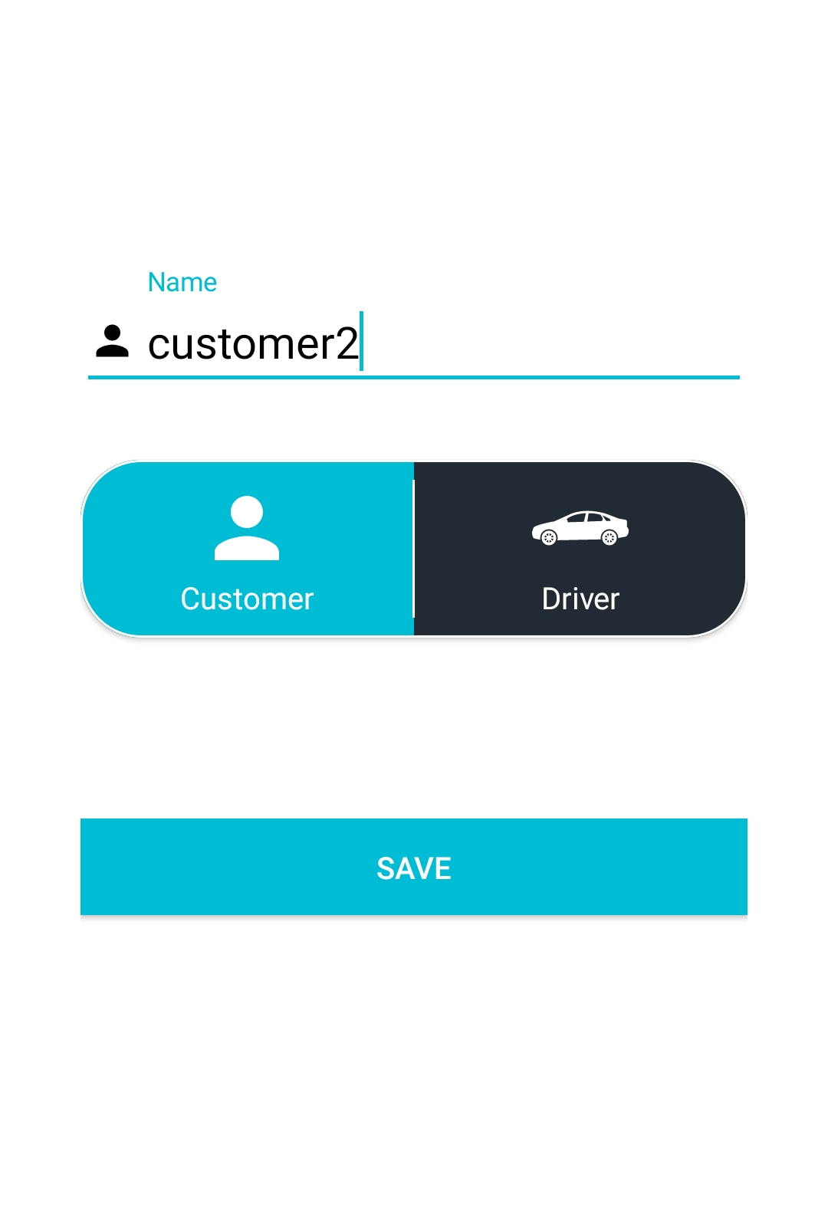
Registration
Next, the user is given the choice to register as a driver or a regular user.

Slide 5
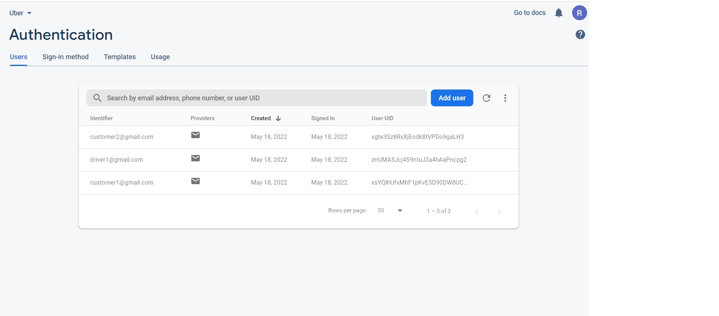
Authentication firebase

Slide 6

Regular User

Slide 7
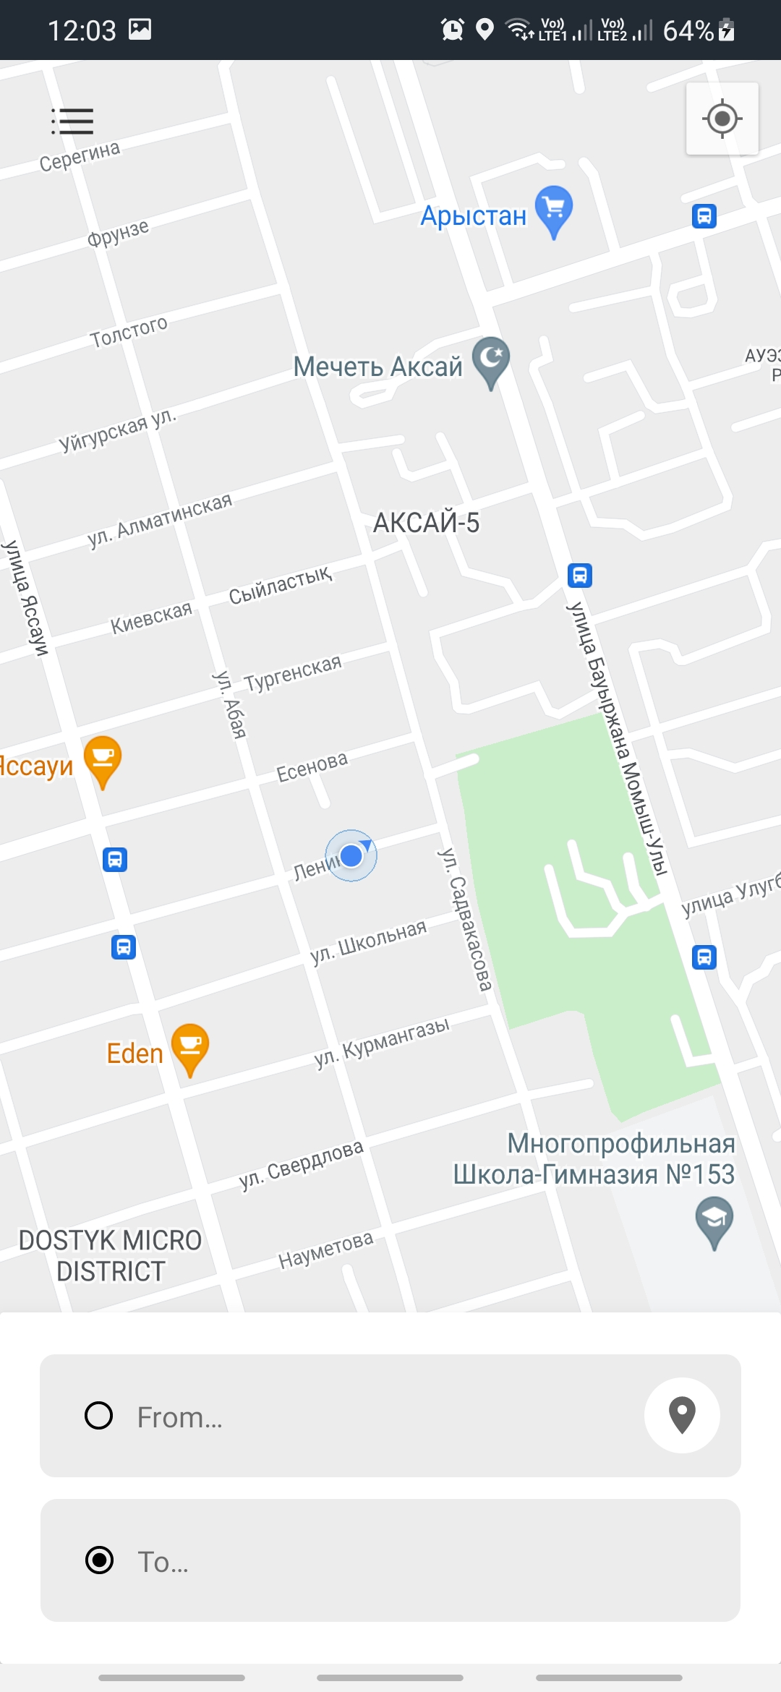
Map
After successful registration, the user is redirected to the main page of our application, here a regular user can order a taxi from point to point

Slide 8
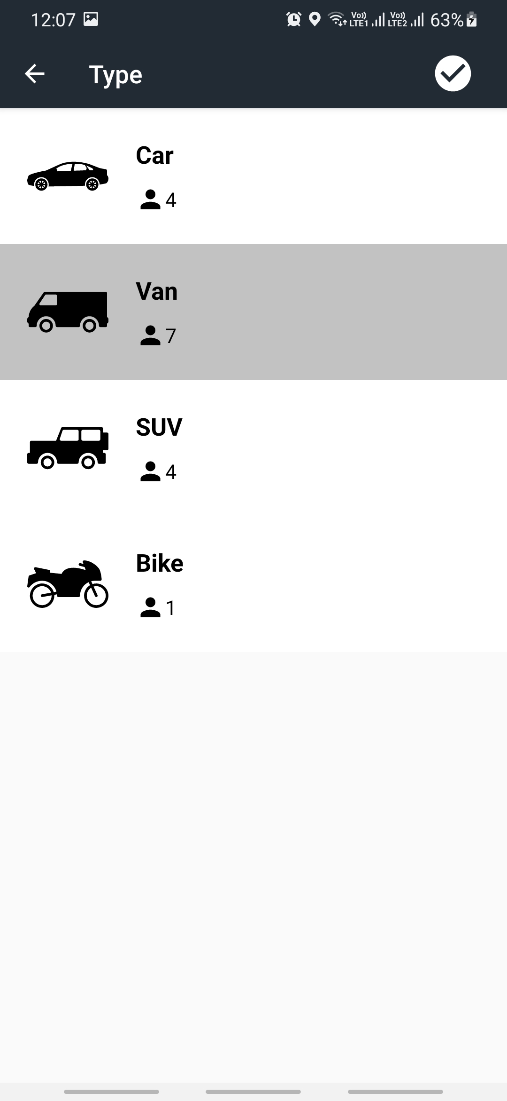
Trip
Here the user, when ordering, can choose what type of machine he needs.

Slide 9
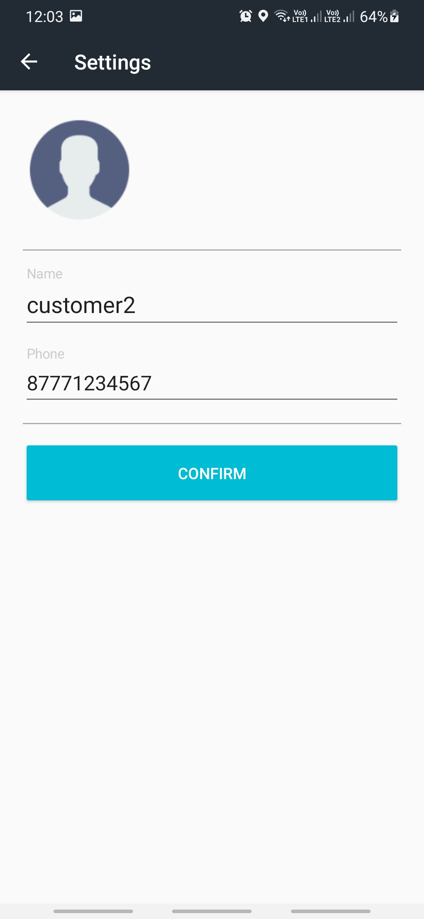
Settings
A regular user can add his number in the settings and also change the name.

Slide 10
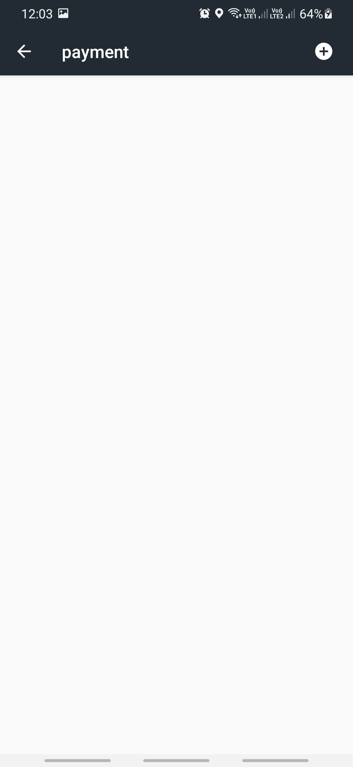
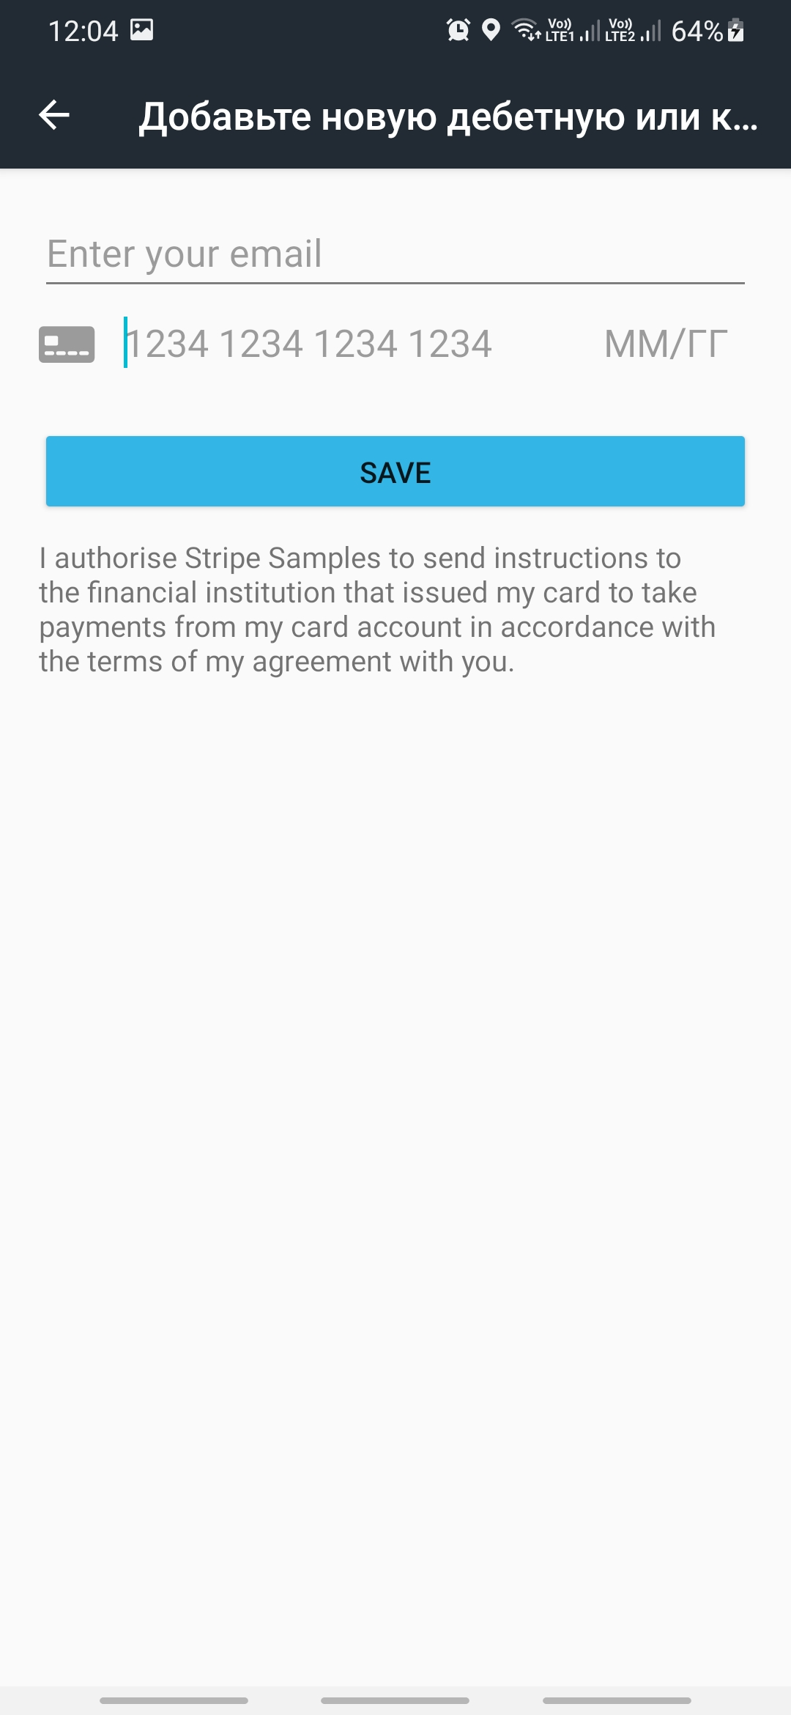
Payment
There is also a tab called payment. On this page, users can add a new credit card or view their old payments.

Slide 11
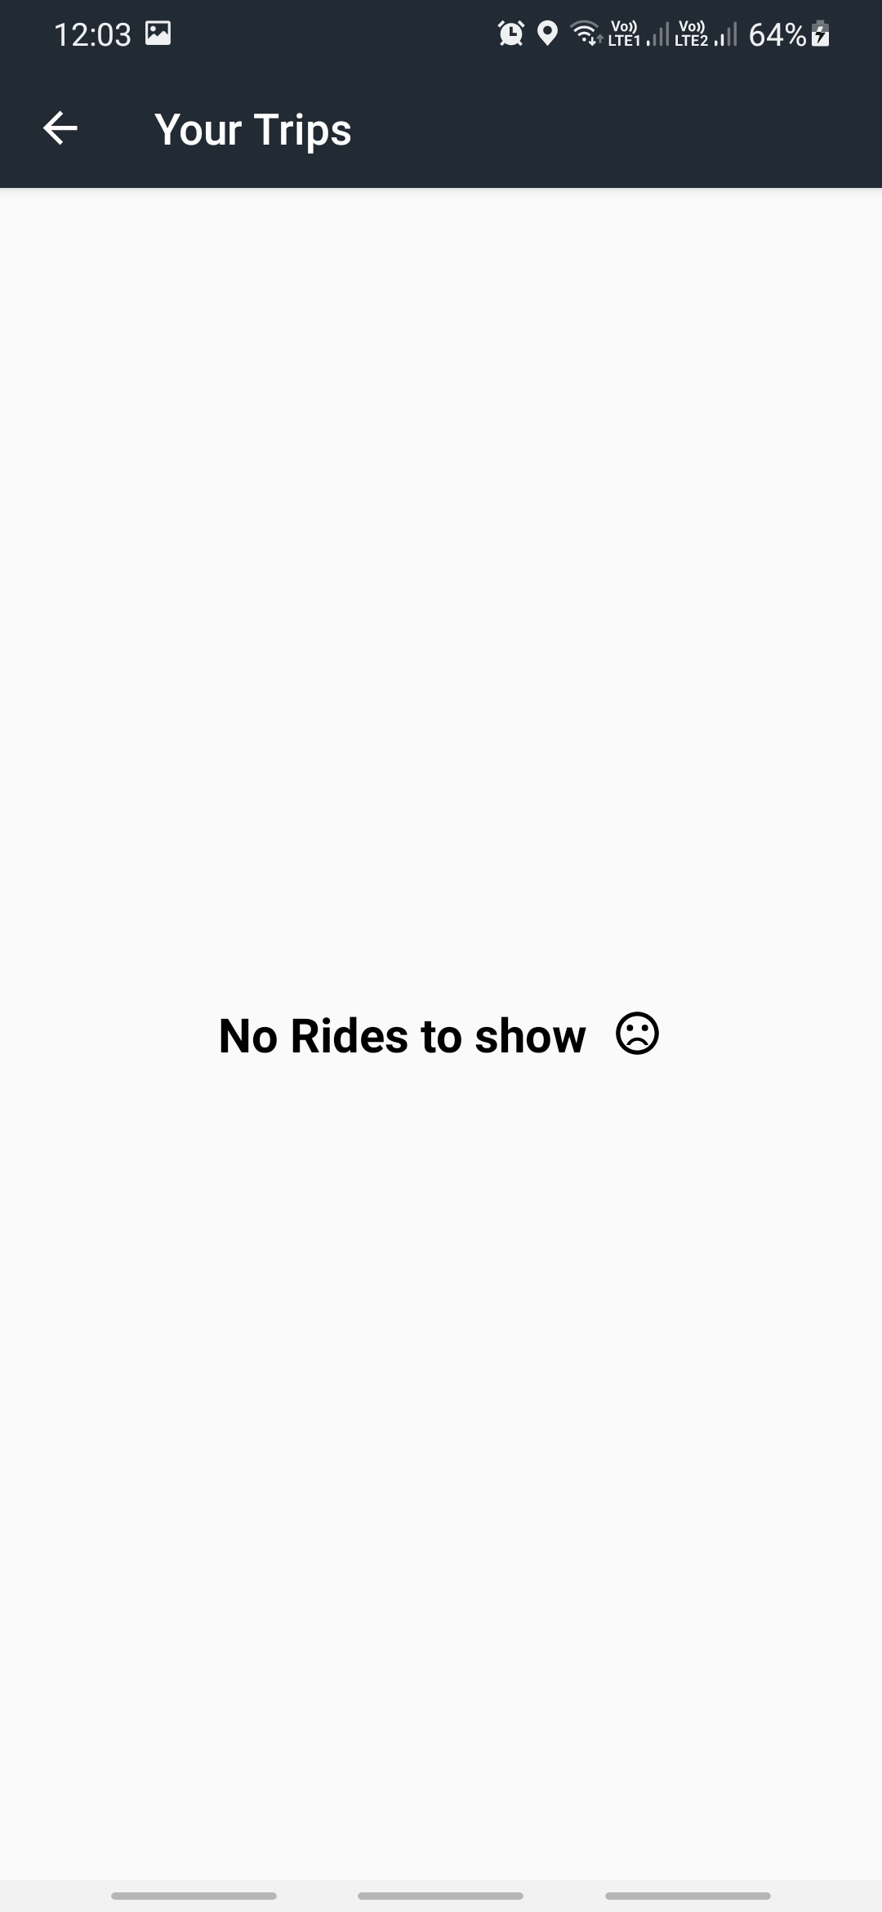
History
In this tab, the user can view the history of the trips he has made

Slide 12
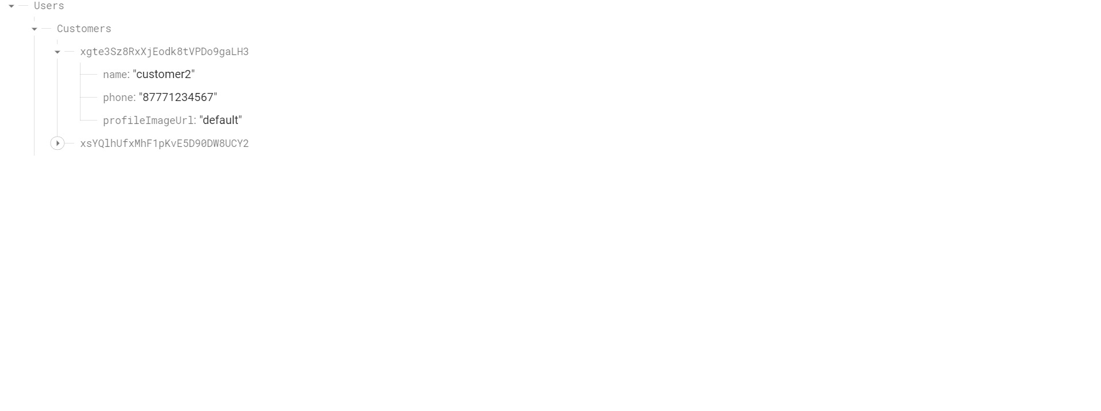
Customer firebase

Slide 13

Driver
Now let's talk about things that are available only to the user who is the driver

Slide 14
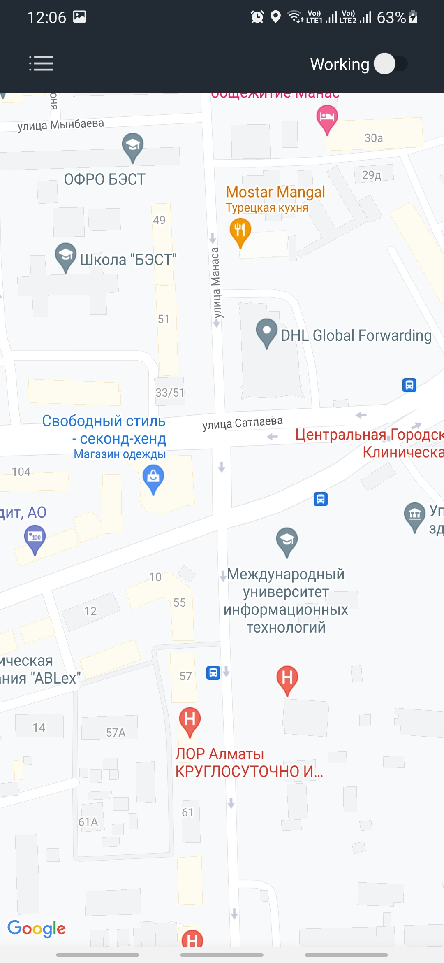
Map
Here the driver can accept the order and note that he is currently at work.

Slide 15
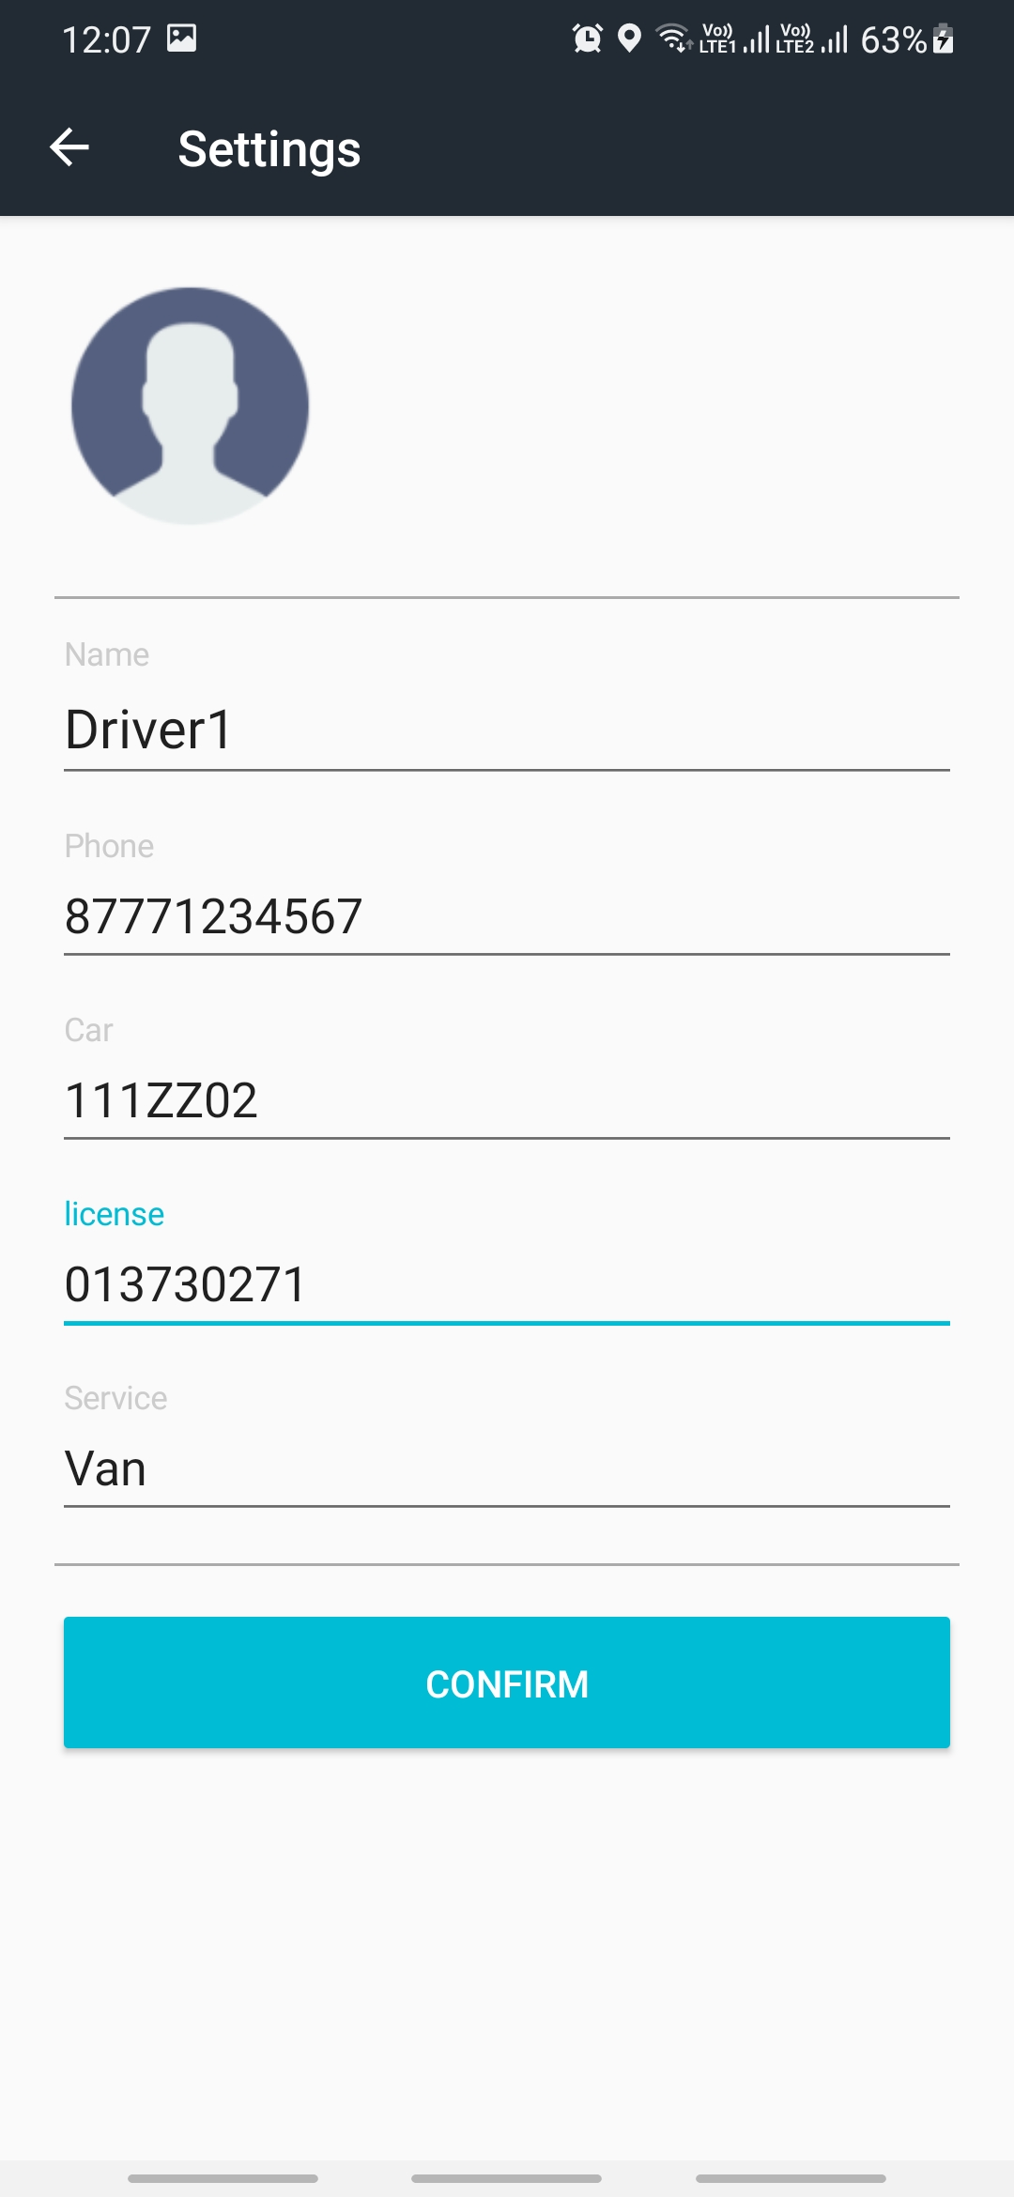
Settings
In the settings, the driver can specify the car number, driver's license number and type of car.

Slide 16
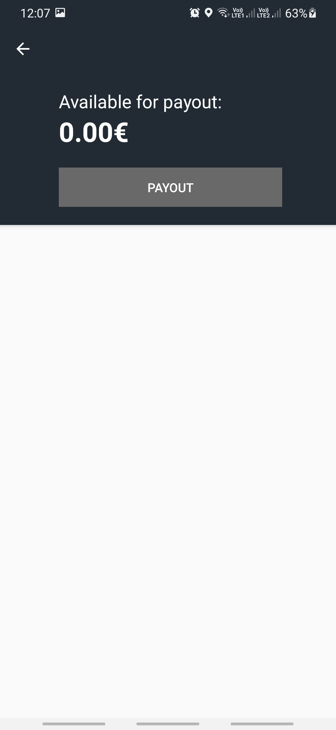
Payout
On this page, the driver can withdraw the amount he earned during working hours

Slide 17
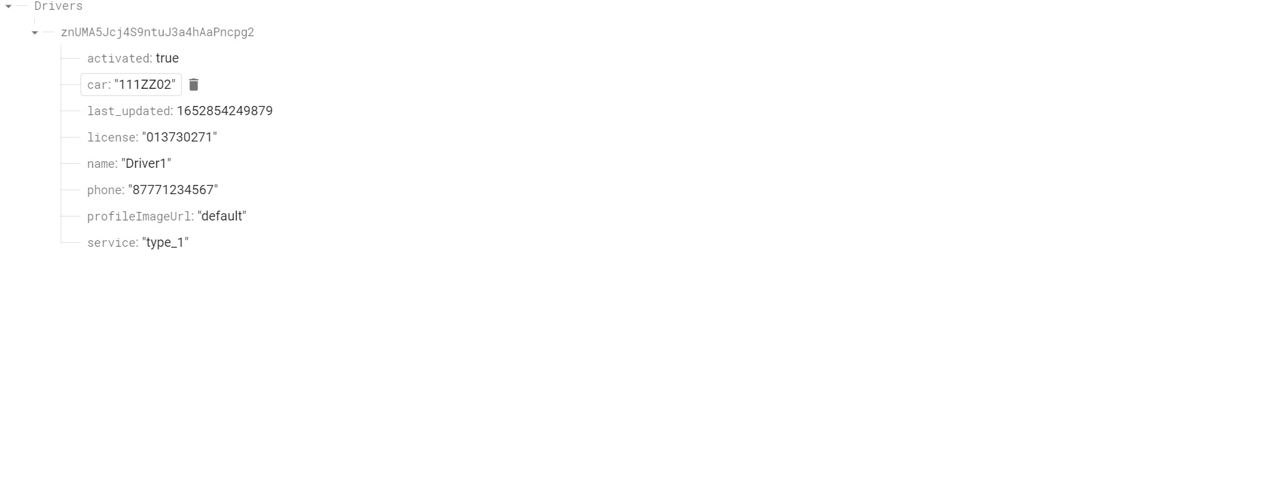
Driver firebase

Slide 18

Thank you for your attention!

